Slide 1
Basketball 2023-24
Rule and Mechanics Meeting

Slide 2
CIF Basketball 2023-24
Michael McNeilly
Email: rulesinterpreterbasketball@gmail.com
Phone: 760-453-3293

Slide 3
2023-24 NFHS Basketball
Rules Changes

Slide 4
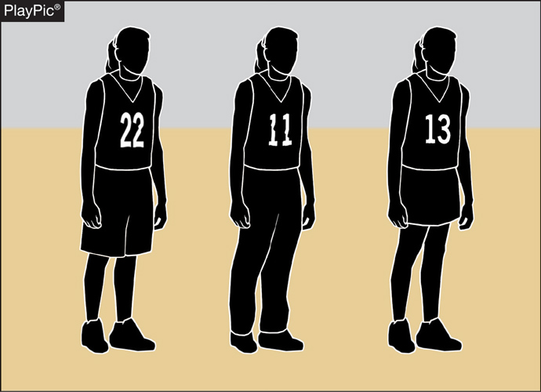
UNIFORMS 3-4-5
Teammates may wear multiple styles of uniform bottoms including shorts, skirts or pants, so long as they are like-colored.
Not all team members need to wear the same style.
However, all styles must meet uniform requirements for visible manufacturer logos and trademarks.
Notes:
Teammates may wear multiple styles of uniform bottoms including shorts, skirts or pants, so long as they are like-colored.
Not all team members need to wear the same style.
However, all styles must meet uniform requirements for visible manufacturer logos and trademarks
Rationale: Clarifies that teammates must all wear like-colored uniform bottoms but may wear multiple styles while aligning language with other NFHS rules codes.

Slide 5
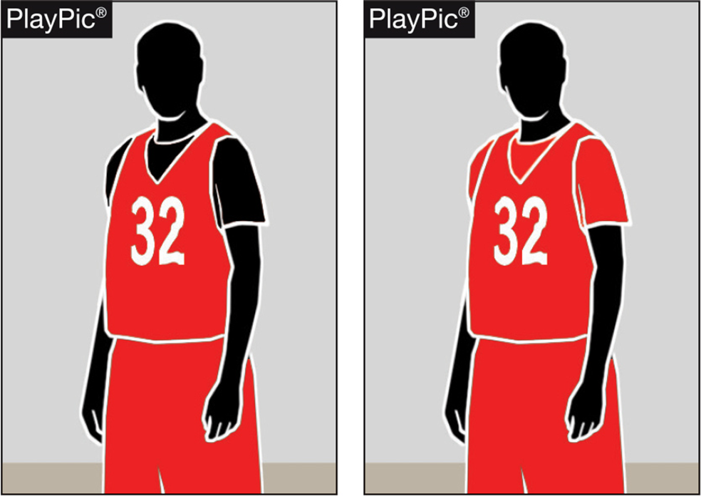
Team Member’s Equipment, Apparel 3-5-6
If the visiting team is wearing undershirts with their dark jerseys, the undershirts may now be a single solid color similar to the torso of the jersey or solid black.
Notes:
If the visiting team is wearing undershirts with their dark jerseys, the undershirts may now be a single solid color similar to the torso of the jersey or solid black.
Rationale: Allows schools with hard-to-find colors to wear black under visiting team jerseys while continuing to require all team members to match.

Slide 6
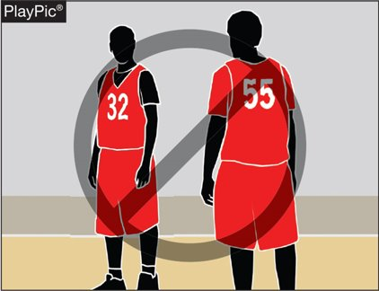
Team Member’s Equipment, Apparel 3-5-6
Team members in this PlayPic may wear either solid black or solid red undershirts, but players on the same team cannot wear both.
If players choose to wear an undershirt, all undershirts must be the same color.
Notes:
Team members in this PlayPic may wear either solid black or solid red undershirts, but players on the same team cannot wear both.
If players choose to wear an undershirt, all undershirts must be the same color.

Slide 7
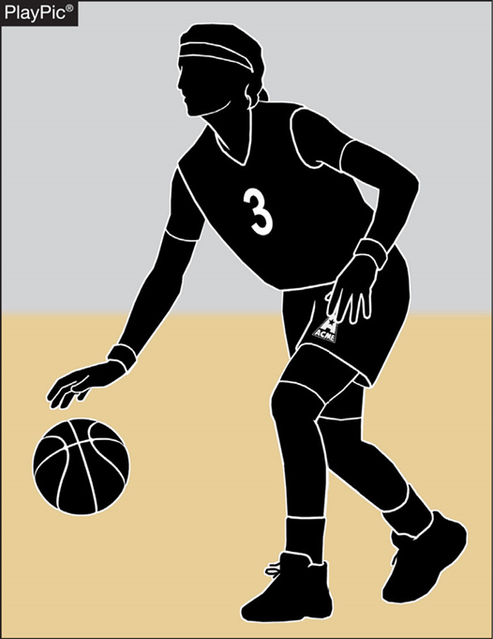
Uniforms, Equipment and apparel
Arm sleeves, knee sleeves, lower leg sleeves, compression shorts and tights are permissible.
Anything worn on the arm and/or leg is a sleeve, except a knee brace, and shall meet the color restrictions.
Sleeves/tights and compression shorts shall be black, white, beige or the predominant color of the jersey and the same color shall be worn by teammates.
All sleeves/tights and compression shorts shall be the same solid color and shall be the same color as any headband or wristband worn.
Notes:
Arm sleeves, knee sleeves, lower leg sleeves, compression shorts and tights are permissible.
Anything worn on the arm and/or leg is a sleeve, except a knee brace, and shall meet the color restrictions.
Sleeves/tights and compression shorts shall be black, white, beige or the predominant color of the jersey and the same color shall be worn by teammates.
All sleeves/tights and compression shorts shall be the same solid color and shall be the same color as any headband or wristband worn.

Slide 8
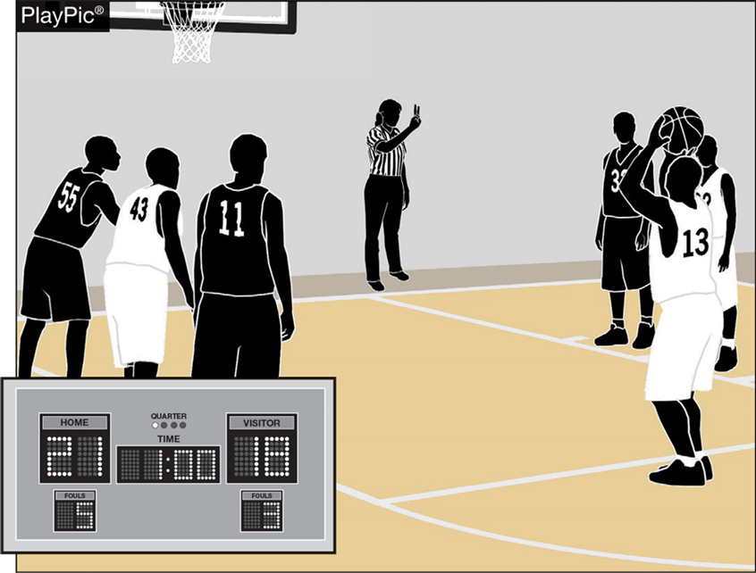
BONUS FREE THROWS 4-8-1
Two free throws will now be awarded for all common fouls, except for a player-control foul or team-control foul, beginning with the fifth team foul in each quarter.
Team fouls will be reset to zero at the end of each quarter, excluding the fourth quarter if an overtime period is needed.
Notes:
Two free throws will now be awarded for all common fouls, except for a player-control foul or team-control foul, beginning with the fifth team foul in each quarter.
Team fouls will be reset to zero at the end of each quarter, excluding the fourth quarter if an overtime period is needed.
Rationale: Improves flow by providing an opportunity for teams to adjust their play by not carrying over fouls from quarters 1 and 3 to quarters 2 and 4 while significantly reducing the opportunity for correctable errors to occur. Minimizes risk of injury by eliminating the one-and-one and reducing opportunities for rough play during rebounding opportunities.

Slide 9
Resumption of play procedure, throw-ins 7-5-2 thru 4 (NEW)
After a violation or a foul before the bonus is in effect by either team or any other stoppage in play, the throw-in location will be determined by the location of the violation/foul or the location of the ball when the stoppage occurs:
Frontcourt throw-in – one of the newly established four designated spots (28-foot mark along each sideline or 3-feet outside the lane line along the end line).
Backcourt throw-in – the designated spot nearest the foul, violation or other stoppage.
Notes:
After a violation or a foul before the bonus is in effect by either team or any other stoppage in play, the throw-in location will be determined by the location of the violation/foul or the location of the ball when the stoppage occurs:
Frontcourt throw-in – one of the newly established four designated spots (28-foot mark along each sideline or 3-feet outside the lane line along the end line).
Backcourt throw-in – the designated spot nearest the foul, violation or other stoppage.
Rationale: Simplifies throw-in procedure when a team gains or retains possession for situations other than an out-of-bounds throw-in.

Slide 10
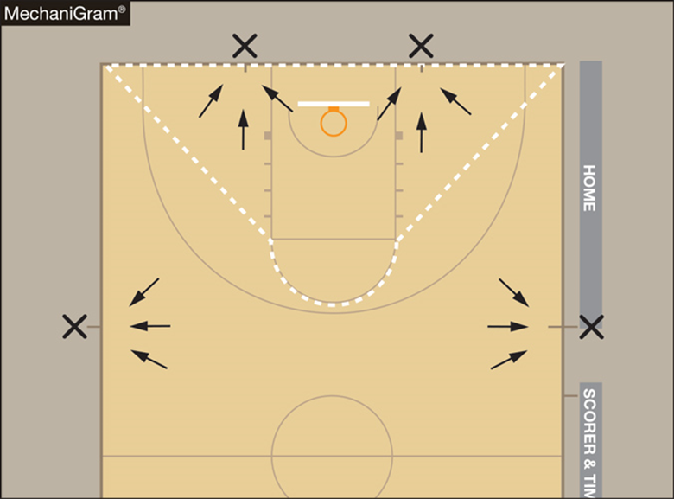
Resumption of play procedure, throw-ins [7-5-2 thru 4 (NEW)]
Frontcourt throw-ins – Officials shall determine the throw-in spot by using an imaginary line (dotted line).
If the stoppage of play occurs inside the dotted imaginary line, the spot shall be the nearest point on the end line 3-feet outside the lane line.
If the stoppage of play occurs outside the dotted imaginary line, the spot shall be the nearest 28-foot mark along each sideline.
NOTE: Court markings are not required.
Notes:
Frontcourt throw-ins – Officials shall determine the throw-in spot by using an imaginary line (dotted line).
If the stoppage of play occurs inside the dotted imaginary line, the spot shall be the nearest point on the end line 3-feet outside the lane line.
If the stoppage of play occurs outside the dotted imaginary line, the spot shall be the nearest 28-foot mark along each sideline.
NOTE: Court markings are not required.

Slide 11
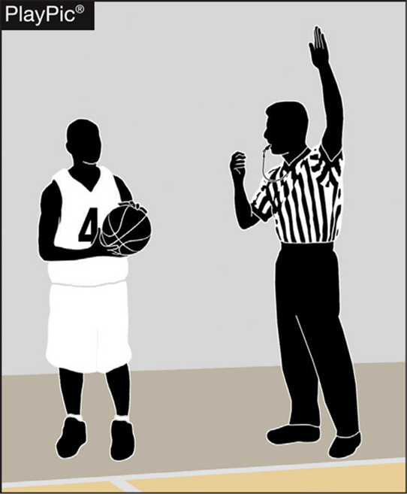
THROW-INS — PROPER LOCATIONS
Proper inbound spots contribute to the overall flow and fairness of the game.
Coaches design specific plays and strategies based on where the ball will be put in play.
It is therefore essential for game officials to be diligent in administering the ball at the proper throw-in location.
Any time a team causes the ball to go out of bounds, the throw-in occurs from the spot where the ball went out of bounds.
Notes:
Proper inbound spots contribute to the overall flow and fairness of the game.
Coaches design specific plays and strategies based on where the ball will be put in play.
It is therefore essential for game officials to be diligent in administering the ball at the proper throw-in location.
Any time a team causes the ball to go out of bounds, the throw-in occurs from the spot where the ball went out of bounds.

Slide 12
Out of BOUNDS 9-3-3
Legal
Illegal
A player may now step out of bounds as long as the player is not the first player to touch the ball, or the player did not step out of bounds to avoid a violation (MechaniGram A).
Any player who steps out of bounds under the player’s own volition and is the first player to touch the ball after returning to the playing court or does so to avoid a violation has committed a violation (MechaniGram B).
Notes:
A player may now step out of bounds as long as the player is not the first player to touch the ball, or the player did not step out of bounds to avoid a violation (MechaniGram A).
Any player who steps out of bounds under the player’s own volition and is the first player to touch the ball after returning to the playing court or does so to avoid a violation has committed a violation (MechaniGram B).
Rationale: Allows a player to step out of bounds if they gain no advantage and penalizes a team only if they gain an advantage by leaving the court and returning to avoid a violation or to be the first to touch the ball.

Slide 13
Questions & Answers

Slide 14
2023-24 NFHS Basketball
Points of Emphasis

Slide 15
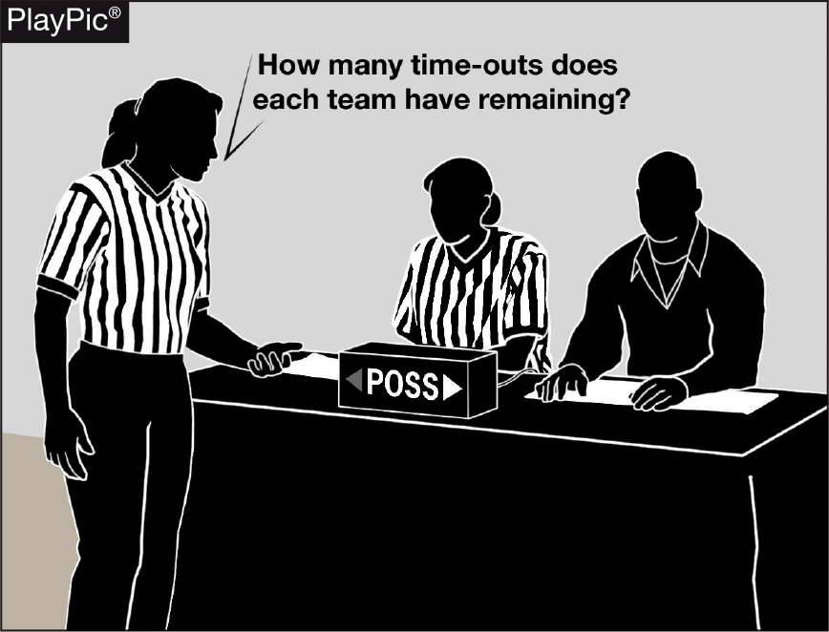
End-of-game protocols
As a game nears the end of playing time, officials need to remind each other of the game-ending procedures to prevent potential issues.
Late-game time-outs provide the best opportunities to:
Confirm scorebook accuracy with the scorer, the number of time-outs remaining for each team and the number of team fouls/impact on the bonus.
Remind the timer to watch officials for clock-start and clock-stop signals and be prepared to assist in aiding officials regarding whether a last-second shot was released prior to the end of time.
Notes:
As a game nears the end of playing time, officials need to remind each other of the game-ending procedures to prevent potential issues.
Late-game time-outs provide the best opportunities to:
Confirm scorebook accuracy with the scorer, the number of time-outs remaining for each team and the number of team fouls/impact on the bonus.
Remind the timer to watch officials for clock-start and clock-stop signals and be prepared to assist in aiding officials regarding whether a last-second shot was released prior to the end of time.

Slide 16
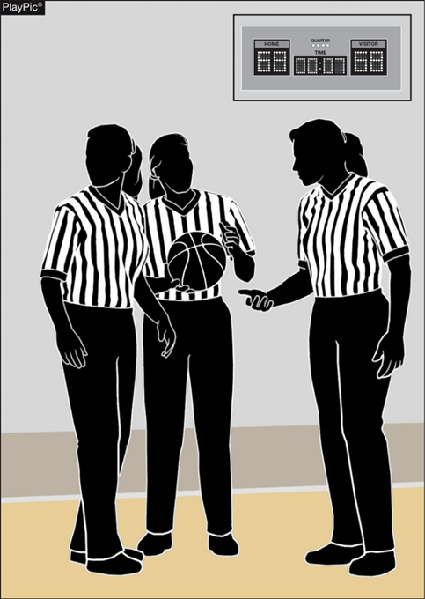
End-of-game protocols
During late-game time-outs the officials should discuss the following among the crew:
Last-second shot responsibility.
Unless the ball is tapped, no try can be attempted on a throw-in or free throw with .3 seconds or less remaining.
Intentional/flagrant fouls are two shots and a designated spot throw-in.
If a foul occurs as the game-ending horn sounds and the score can be tied or the game won by the ensuing free throws, the official must administer the free throws. If they will not change the outcome, they shall not be attempted.
Notes:
During late-game time-outs the officials should discuss the following among the crew:
Last-second shot responsibility.
Unless the ball is tapped, no try can be attempted on a throw-in or free throw with .3 seconds or less remaining.
Intentional/flagrant fouls are two shots and a designated spot throw-in.
If a foul occurs as the game-ending horn sounds and the score can be tied or the game won by the ensuing free throws, the official must administer the free throws. If they will not change the outcome, they shall not be attempted.

Slide 17
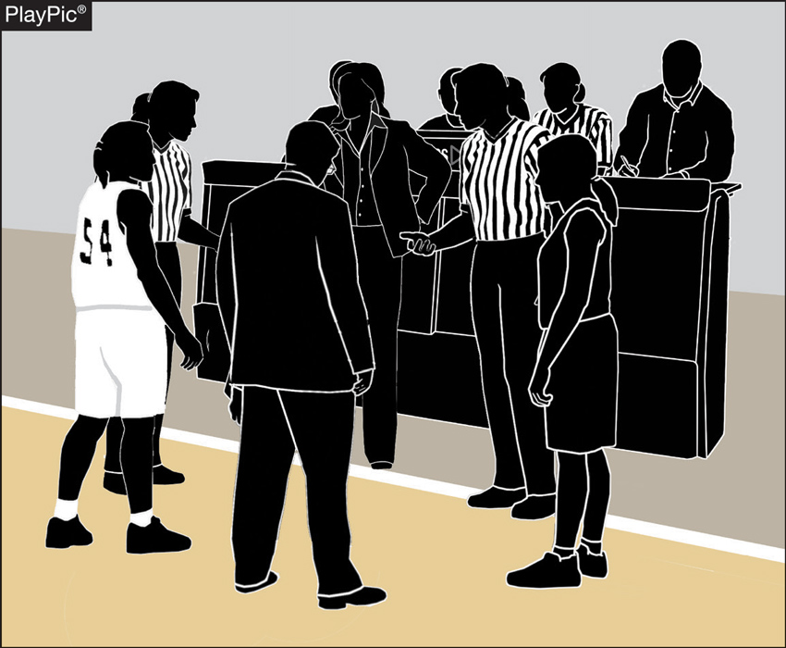
End-of-game protocols
If the score is tied at the end of regulation time, inform each team and the table officials of the overtime procedures (length of overtime period, additional 60-second time-out, etc.).
Notes:
If the score is tied at the end of regulation time, inform each team and the table officials of the overtime procedures (length of overtime period, additional 60-second time-out, etc.).

Slide 18
End-of-game protocols
Following the game-ending horn, the referee should confirm with the scorer that everything is correct, then leave the floor with their partner(s).
In situations when the score is separated by three points or less, it may be necessary to verbally confirm with the scorer.
In games when the margin of victory is larger, a visual signal such as a thumb’s-up will suffice.
Be confident everything is correct, as the officials’ jurisdiction ends when the entire crew leaves the visual confines of the playing court.
Notes:
Following the game-ending horn, the referee should confirm with the scorer that everything is correct, then leave the floor with their partner(s).
In situations when the score is separated by three points or less, it may be necessary to verbally confirm with the scorer.
In games when the margin of victory is larger, a visual signal such as a thumb’s-up will suffice.
Be confident everything is correct, as the officials’ jurisdiction ends when the entire crew leaves the visual confines of the playing court.

Slide 19
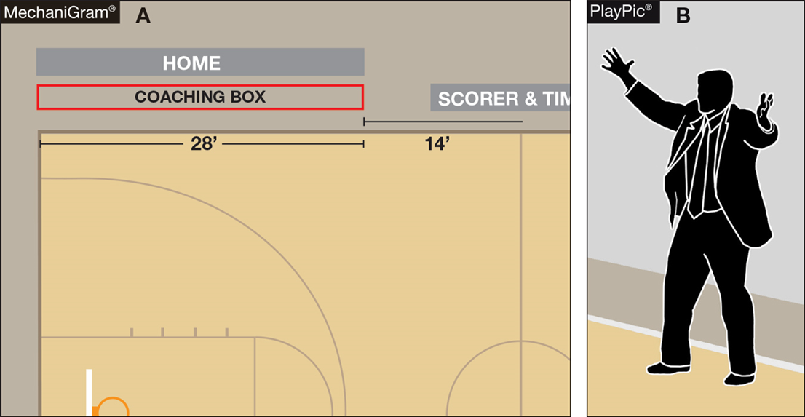
BENCH DECORUM
Through the enforcement of existing rules, coaches and bench personnel are expected to exhibit appropriate and acceptable behaviors.
Coaches are expected to remain in the coaching box.
Coaches who go beyond the 28-foot line, or more importantly onto the playing court, gain a distinct advantage that is not within the spirit or intent of the rules.
Notes:
Through the enforcement of existing rules, coaches and bench personnel are expected to exhibit appropriate and acceptable behaviors.
Coaches are expected to remain in the coaching box.
Coaches who go beyond the 28-foot line, or more importantly onto the playing court, gain a distinct advantage that is not within the spirit or intent of the rules.

Slide 20
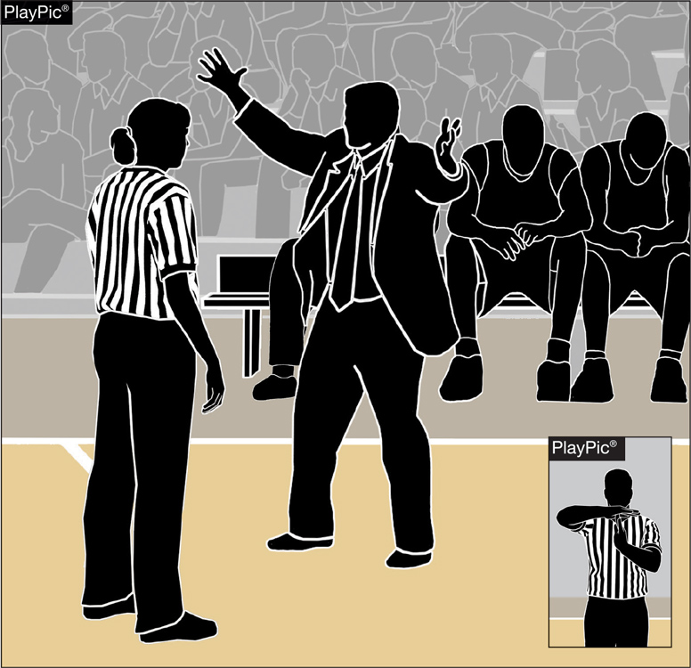
BENCH DECORUM
While the bench area expands during a time-out, the bench area does not extend beyond the 28-foot line.
Coaches and other bench personnel may not move to the extended bench area until the time-out begins to ensure bench personnel do not create inadvertent contact with opposing players still on the playing court.
Coaches who leave the expanded bench area to engage officials inappropriately are subject to a warning or bench technical foul.
Notes:
While the bench area expands during a time-out, the bench area does not extend beyond the 28-foot line.
Coaches and other bench personnel may not move to the extended bench area until the time-out begins to ensure bench personnel do not create inadvertent contact with opposing players still on the playing court.
Coaches who leave the expanded bench area to engage officials inappropriately are subject to a warning or bench technical foul.

Slide 21
Sportsmanship
CIF Bylaw 503 Section M Article 9
Spectator: If a spectator is ejected from a contest, it is the responsibility of the school to ensure that person does not attend the team’s next contest. If the same spectator is ejected a second time, it is the responsibility of the school to ensure that person does not attend any of the remaining contests for that season.
Protocol:
Identify the spectator to the school administrator
Report the ejection to the unit leader with as much detail as possible
Unit leader reports the ejection to Executive Director and/ or the Section Commissioner

Slide 22
CIF Guidelines on Touching Players
We do not under any circumstances touch a player!
If a fight breaks out during your game, we are not to get involved.
Do not get between players that have already started pushing or punching
Do not pull players away from each other
Our job is to stay back and take notes
Let the coaches address their players if need be
Make sure that you are vigilant in who was involved and who came off the bench
Officials will be suspended for contact with players

Slide 23
Questions & Answers

Slide 24
Conclusion
Biweekly email highlighting POE and Plays
Please share any video that you have questions on a play call
Video plays to pass on to your unit
I will only be sending them to those identified as leaders of their units
Survey on which day of the week we should meet next season

Slide 25
CIF Basketball 2023-24
Michael McNeilly
Email: rulesinterpreterbasketball@gmail.com
Phone: 760-453-3293

