Slide 1
2022 nfhs football rules changes
Dr. Ronnie Higgs email: tbird1149@gmail.combird1149@gmail.com
Notes:
Dr. Ronnie Higgs email: tbird1149@gmail.com

Slide 2
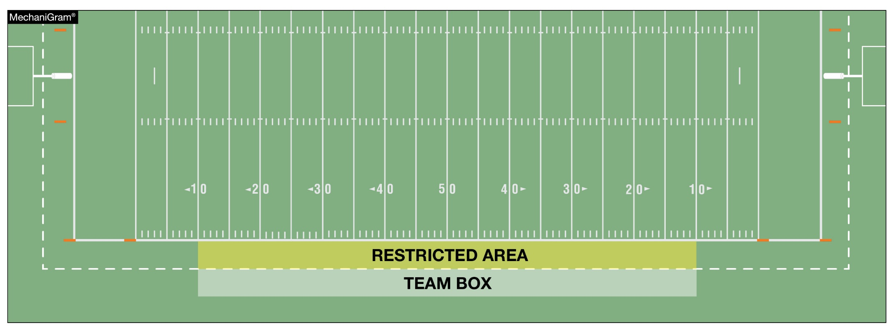
TEAM BOXES rule 1-2-3g NOTES 3. (NEW), TABLE 1-7 (3.) (New)
It is permissible for state associations to approve an extension of the team box and to determine the individuals who may be in the extended area, provided such extension is the same for both teams. ***California will still use 25 yd line***
Notes:
Rule Change:
RULE 1 – SECTION 2 THE FIELD ANE MARKINGS …
ART. 3 . . . Lines and other markings: …
g. Team boxes shall be marked on each side of the field outside the coaches’ area between the 25-yard lines for use of coaches, substitutes, athletic trainers, etc., affiliated with the team. The coaches' area is a minimum of a 2-yard belt between the front of the team box and the sideline, and becomes a restricted area when the ball is live.
NOTES:
It is permissible for state associations to approve an extension of the team box and to determine the individuals who may be in the extended area, provided such extension is the same for both teams.
***California did not choose to extend team box..
Rationale for Change:
By state association adoption, the team box may now be extended beyond the 25-yard line.

Slide 3
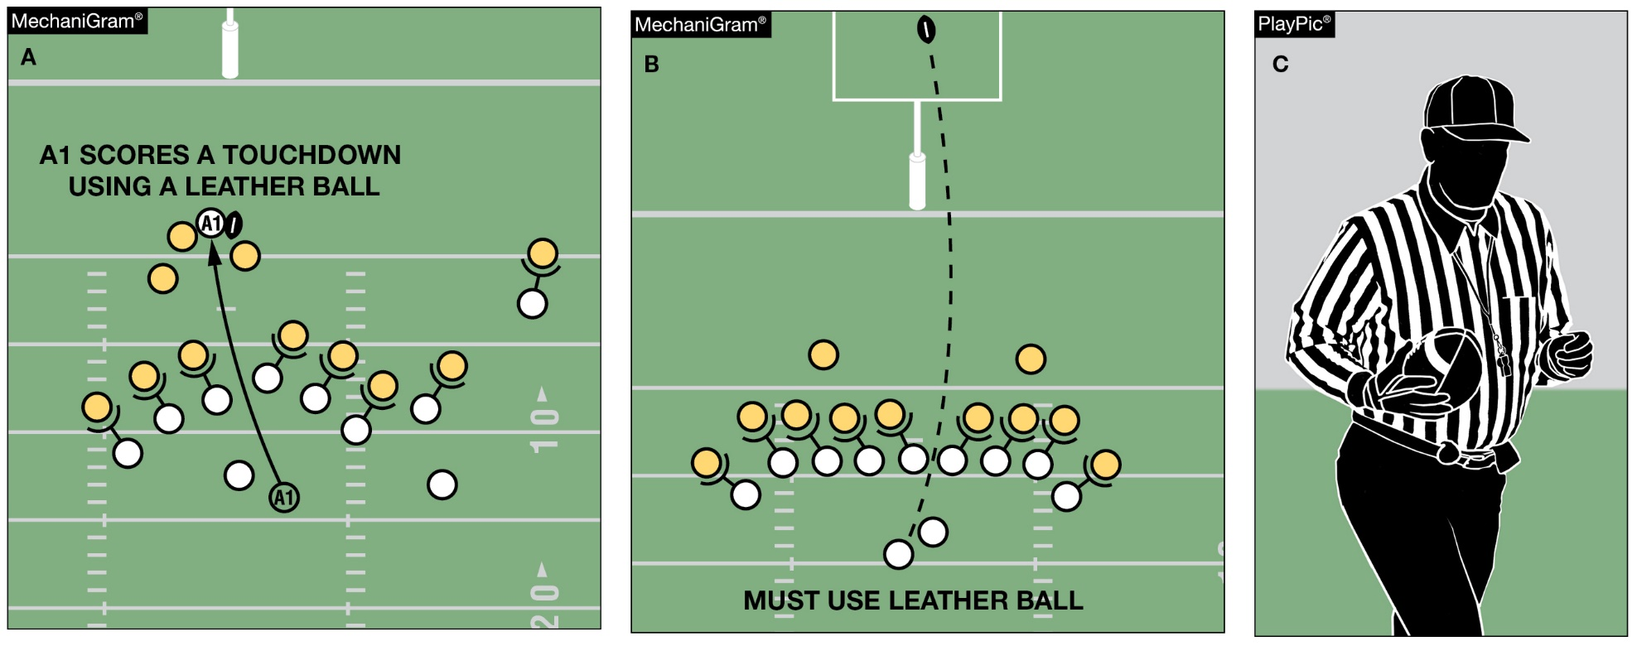
Game balls rule 1-3-3
Any game official may order the ball changed between downs. Unless the ball is ordered changed by the Referee or another game official, Team A scoring a touchdown with one ball (MechaniGram A) may not request a different ball for the try (MechaniGram B) but may use a different approved ball for the ensuing free kick (PlayPic C).
Notes:
Rule Change:
RULE 1 – SECTION 3 GAME EQUIPMENT …
ART. 3 . . . The referee shall decide whether the ball meets specifications, and the referee or any other game official may order the ball changed between downs.
Rationale for Change:
Any game official may order the ball changed between downs. ie..Long incomplete pass; inclement weather;
A Team does not have option to change balls.

Slide 4
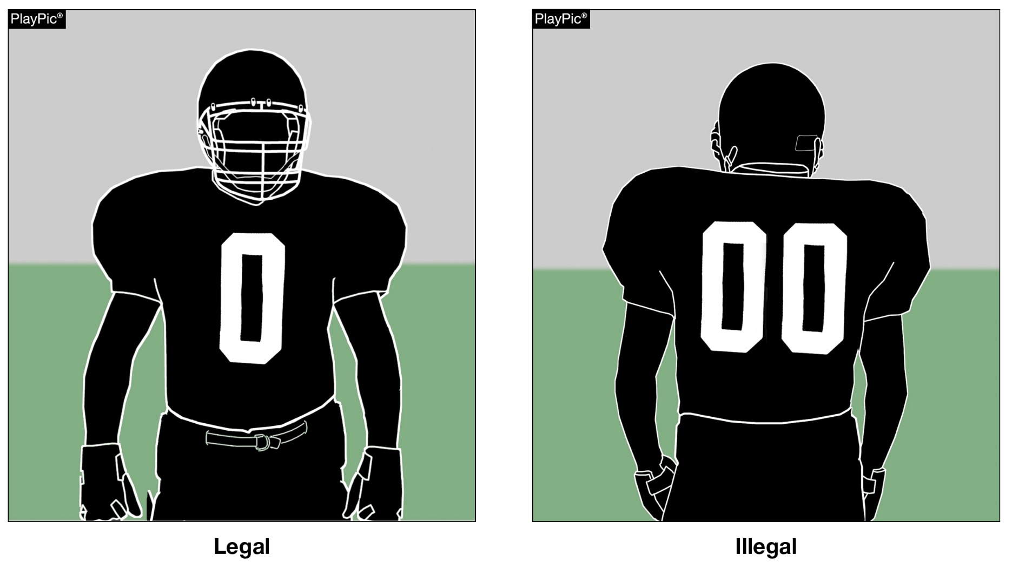
Jersey numbers rule 1-4-3, FIGURE 1-4-2, Rule 1-5-1c(1), rule 7-2-5b EXCEPTIONS, RULE 7-5-6a
Each player shall be numbered 0 though 99 inclusive. Any number preceded by the digit zero such as “00” is illegal.
Notes:
Rule Change:
RULE 1 – SECTION 4 PLAYER DESIGNATIONS …
ART. 3 . . . Each player shall be numbered 0 through 99 inclusive. Any number preceded by the digit zero is illegal. See 7-2-5.
RULE 7 – SECTION 2 FORMATION/POSITION, NUMBERSING AND ACTION AT THE SNAP …
ART. 5 . . . Player formation and numbering requirements include:
a. No more than four A players may be backs and only one A player
b. At the snap, at least five A players on their line of scrimmage must be numbered 50-79.
EXCEPTIONS:
1. On first, second or third down, when A sets or shifts into a scrimmage-kick formation as in 2-14-2a, the snapper may be a player numbered 0 to 49 or 80 to 99. If Team A has the snapper in the game under this exception, Team A shall have four players wearing numbers 50-79 on its line of scrimmage. The snapper in the game under this exception must be between the ends and is an ineligible forward-pass receiver during that down unless the pass is touched by B (7-5-6b).
2. On fourth down or during a kick try, when A sets or shifts into a scrimmage-kick formation, any A player numbered 0 to 49 or 80 to 99 may take the position of any A player numbered 50 to 79. A player in the game under this exception must assume an initial position on his line of scrimmage between the ends and he remains an ineligible forward-pass receiver during that down unless the pass is touched by B (7-5-6b).
RULE 7 – SECTION 5 FORWARD-PASS CLASSIFICATION …
ART. 6 . . . Pass eligibility rules apply only to a legal forward pass. The following players are eligible pass receivers:
All A players eligible by position and number including those who, at the time of the snap, are on the ends of their scrimmage line or legally behind the line (possible total of six) and are numbered 0-49 or 80-99. (7-2-5b EXCEPTION 2)
Rationale for Change:
The single digit number "0" is now a legal number.

Slide 5
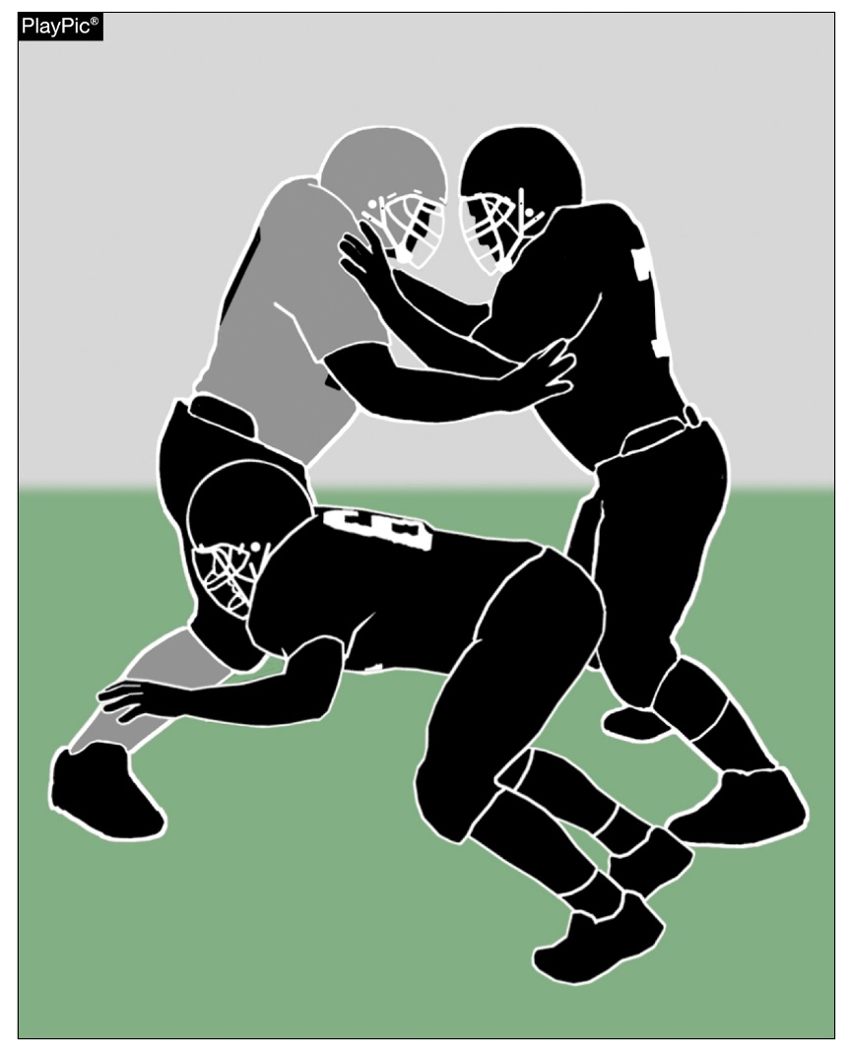
CHOP BLOCK RULE 2-3-8
A chop block is combination block by two or more teammates against an opponent other than the runner, with or without delay, where one of the blocks is below the waist and one of the blocks is above the waist.
Notes:
Rule Change:
RULE 2 – SECTION 3 BLOCKING …
ART. 8 . . . Chop block is a combination block by two or more teammates against an opponent other than the runner, with or without delay, where one of the blocks is below the waist and one of the blocks is above the waist.
***Use to be the knee***
Rationale for Change:
A chop block has been redefined as an illegal combination block where contact is made above and below the waist.
Case Book: See SITUATION 9.3.2F
CORRECTED - 9.3.2 SITUATION F: A1 and A2 combine in blocking B1 as follows: (a) both block B1 downfield with A1 making contact above the waist and A2 simultaneously making contact below the waist but above the knees; or (b) both block B1 in the free-blocking zone with A1's block above the waist and A2's block below the waist; or (c) A1 blocks B1 above the waist as part of immediate, initial action following the snap and at the same time, A2 blocks B1 below the waist and above the knees; or (d) both A1 and A2 block B1 below the knees from the front of B1 while in the free-blocking zone. RULING: In (a), (b) and (c) illegal chop block by A2; Illegal block below the waist by A2 in (a) since the block is not in the free-blocking zone even if part of the immediate, initial action following the snap; in (b) illegal chop block by A2; in (c) the block by A2 is legal if both blockers were on the line of scrimmage and in the free-blocking zone at the snap and the block was part of the immediate, initial action following the snap; in (d) this combination or multiple block is legal if the block and both blockers were in the free-blocking zone at the snap and the block was part of the immediate, initial action following the snap. (2-17-2, 9-3-6)

Slide 6
Game clock option RULE 3-4-7
When a foul is committed with less than two minutes remaining in either half, the offended team has the option to start the game clock on the snap. In MechaniGram A, Team B trails when Team A fouls. Team B’s coach is consulted (PlayPic B), choosing to decline the penalty and have the clock started on the snap (PlayPic C).
Notes:
Rule Change:
RULE 3 – SECTION 4 STARTING AND STOPPING THE GAME CLOCK …
ART. 7 . . . When a foul is committed with less than two minutes remaining in either half, the offended team will have the option to start the game clock on the snap. **Do not have to accept penalty**
Rationale for Change:
Changed the offended team's game clock options following a foul committed with less than two minutes remaining in either half.
Case Book: See SITUATIONS 3.4.7A, 3.4.7C, 3.4.7D

Slide 7
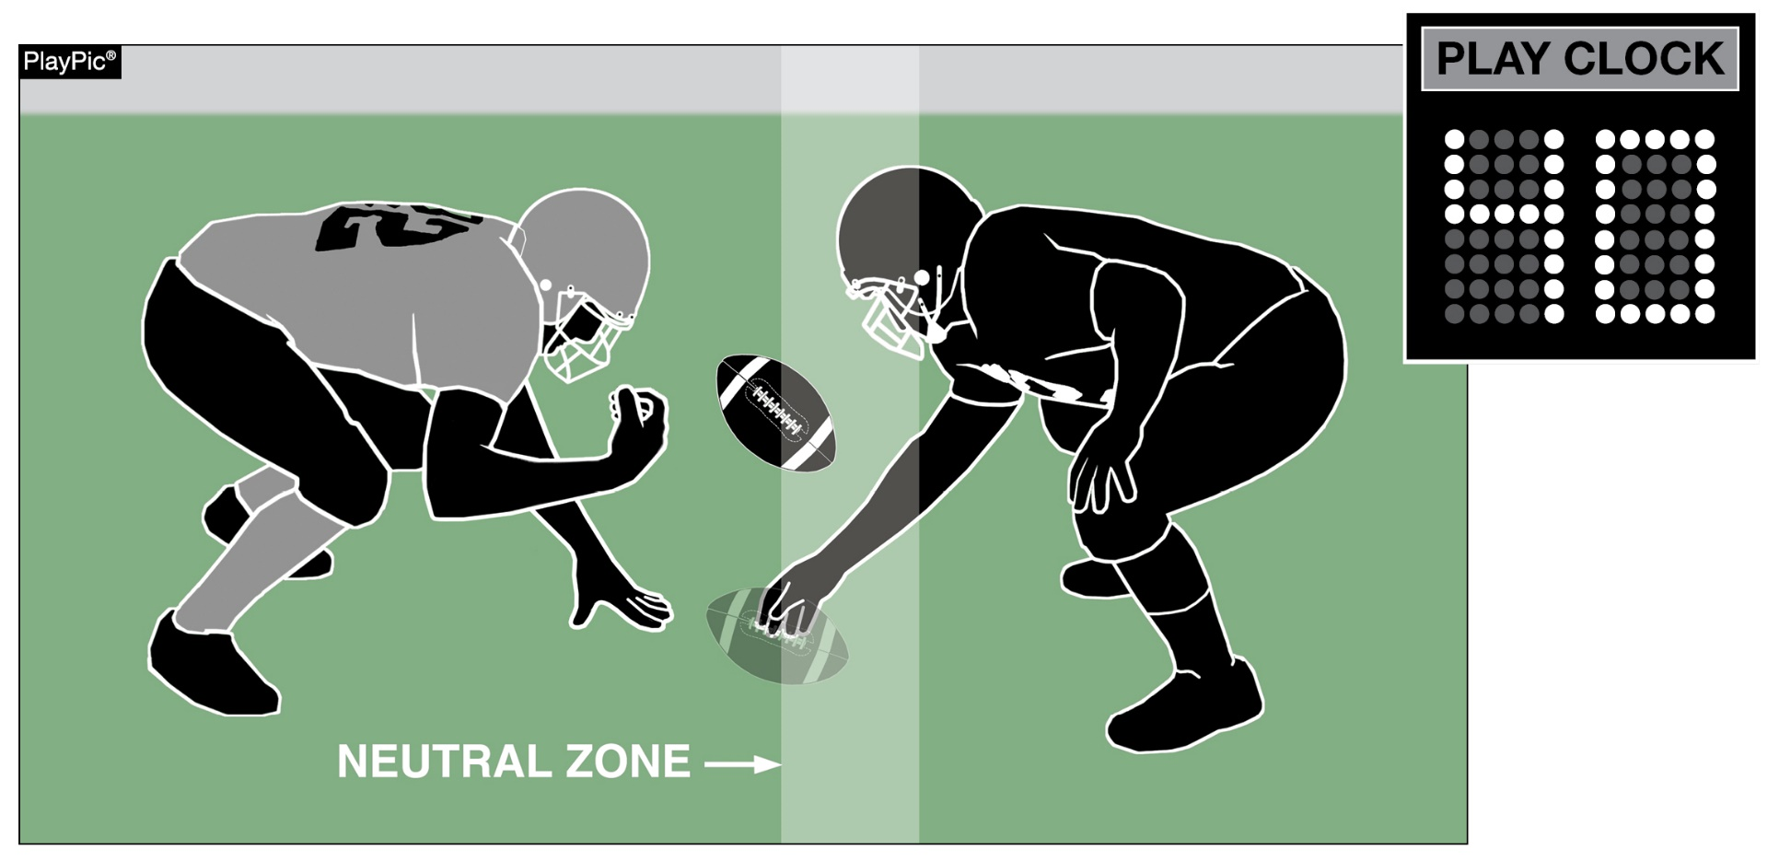
PLAY CLOCK RULE 3-6-1a(1)e EXCEPTION 2. (NEW)
When the clock is stopped due to Rule 3-5-7i and Team B is the only team to foul, the play clock will be set to 40 seconds.
Notes:
Rule Change:
RULE 3 – SECTION 6 PLAY CLOCK, BALL READY FOR PLAY AND DELAY …
ART. 1 . . . Play clock and ready-for-play:
a. Play clock:
1. 25 seconds will be on the play clock and start on the ready-for-play signal:
(a) Prior to a try following a score;
(b) To start a period or overtime series;
(c) Following administration of an inadvertent whistle;
(d) Following a charged time-out;
(e) Following an official's time-out as in 3-5-7 or 3-5-10.
EXCEPTIONS:
1. 3-5-7b;
2. 3-5-7e, 3-5-7i or 3-5-10 if related to a defensive player.
Rationale for Change:
Added a new exception to the play clock administration following a foul committed only by the defensive team.

Slide 8
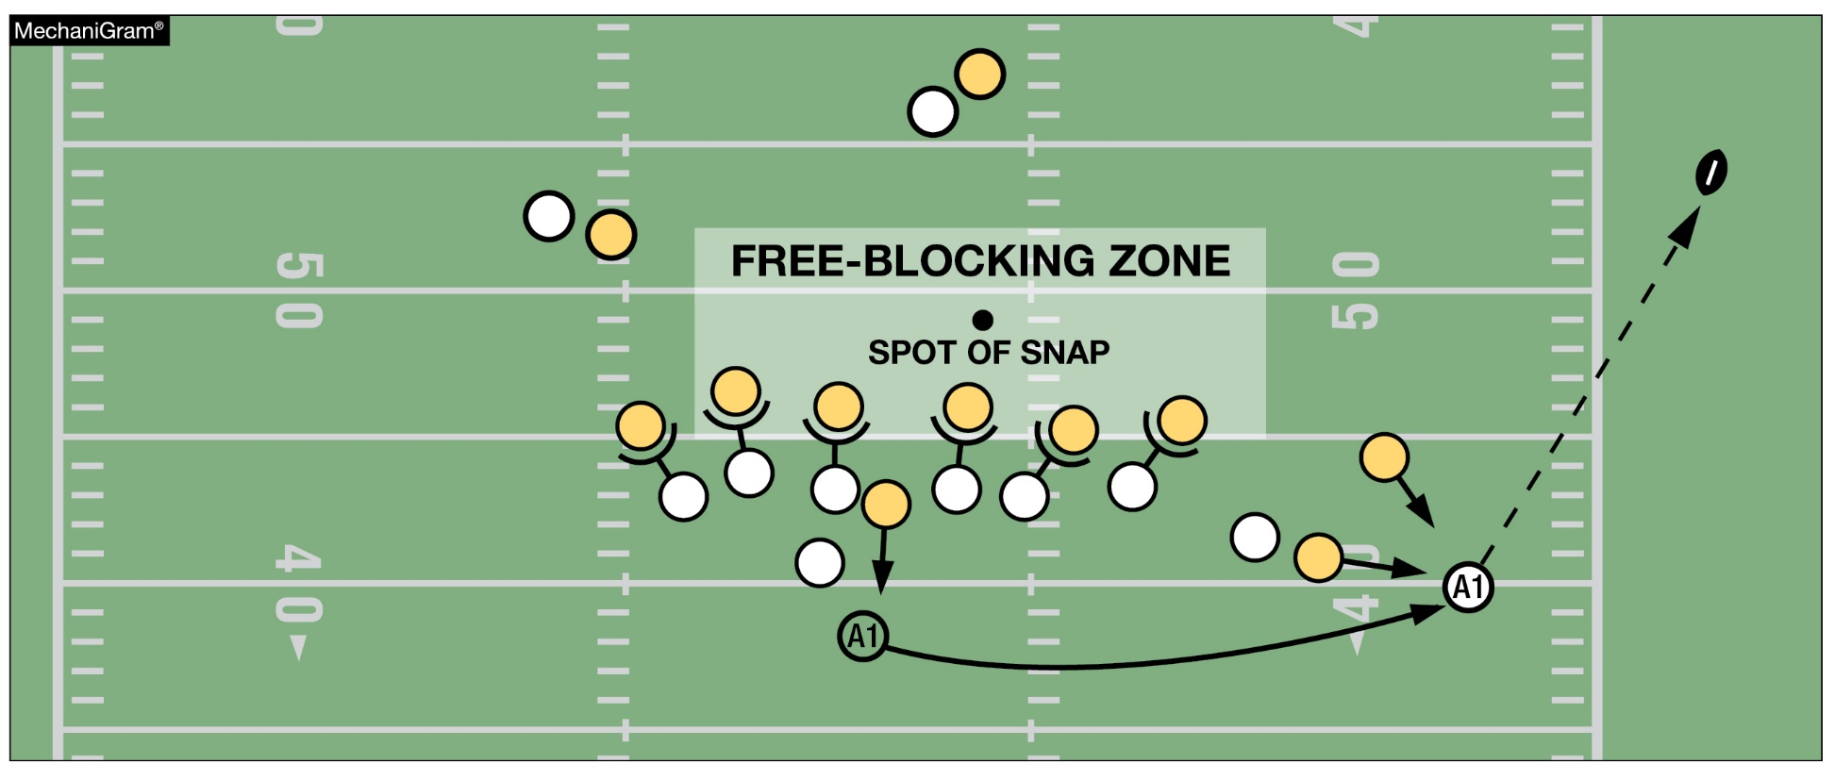
INTENTIONAL GROUNDING RULE 7-5-2d EXCEPTION 2. (NEW), TABLE 7-5-2, TABLE 7-5
It is legal for a player to conserve yardage by intentionally throwing an incomplete forward pass if the passer has been beyond the lateral boundary of the free-blocking zone as established at the snap; and the pass reaches the neutral zone, including the extension beyond the sideline.
Notes:
Rule Change:
RULE 7 – SECTION 5 FORWARD-PASS CLASSIFICATION …
ART. 2 . . . An illegal forward pass is a foul. Illegal forward passes include:
a. A pass after team possession has changed during the down.
b. A pass from beyond the neutral zone.
c. A second and subsequent forward pass(es) thrown during a down.
d. A pass intentionally thrown into an area not occupied by an eligible offensive receiver, or thrown incomplete to save loss of yardage or to conserve time.
EXCEPTIONS:
1. It is legal for a player positioned directly behind the snapper to conserve time by intentionally throwing the ball forward to the ground immediately after receiving the snap that has neither been muffed nor touched the ground.
2. It is legal for a player to conserve yardage by intentionally throwing an incomplete forward pass if:
a. The passer has been beyond the lateral boundary of the free-blocking zone as established at the snap; and
b. The pass reaches the neutral zone, including the extension beyond the sideline.
Rationale for Change:
Added a new exception that allows the passer to legally throw the ball away to conserve yardage.
Case Book: See SITUATIONS 7.5.2A, 7.5.2C

Slide 9
2022 nfhs football rules reminders

Slide 10
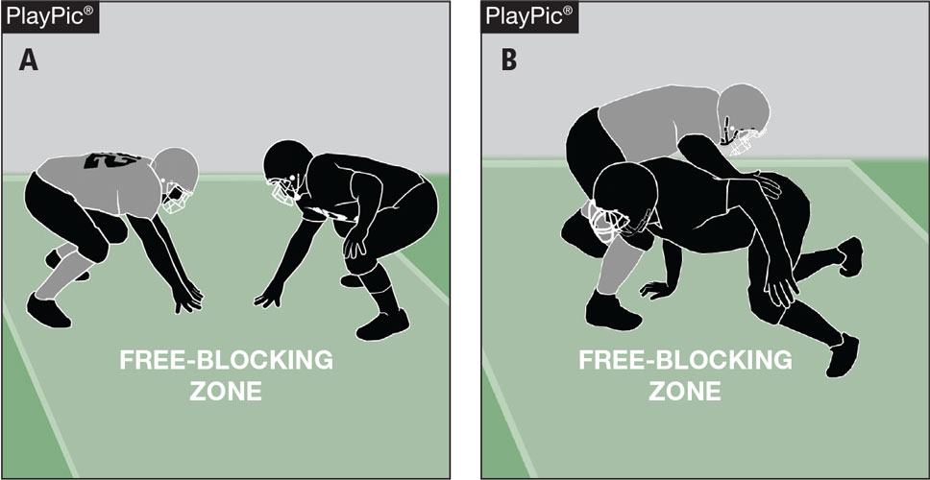
blocking below the waist Rule 2-17-2c
In PlayPic A, both players are in the free-blocking zone and on their lines of scrimmage. In PlayPic B, the block is legal because it is in the zone at the time of the snap, is an immediate, initial action following the snap, and both players began the play on their lines of scrimmage and in the free-blocking zone.
Notes:
Rules Reminder:
RULE 2 – SECTION 17 – FREE-BLOCKING ZONE – LEGAL BLOCKING BELOW THE WAIST AND LEGAL BLOCK IN THE BACK
ART. 1 . . . The free-blocking zone is a rectangular area extending laterally 4 yards either side of the spot of the snap and 3 yards behind each line of scrimmage. A player is in the free-blocking zone when any part of his body is in the zone at the snap.
ART. 2 . . . Blocking below the waist is permitted in the free-blocking zone when the following conditions are met:
a. All players involved in the blocking are on the line of scrimmage and in the zone at the snap.
b. The contact is in the zone.
c. The block is an immediate, initial action following the snap.
Comment on Slide:
Rule change in 2021. Further clarified that blocking below the waist now requires the block to begin immediately following the snap.
Due to the 2021 NFHS change in the blocking below the waist rule, game officials should be aware of the start of the block.
Case Book: See SITUATIONS 9.3.2A, 9.3.2B, 9.3.2C, 9.3.2D, 9.3.2E, 9.3.2F, 9.3.2G, 9.3.2H

Slide 11
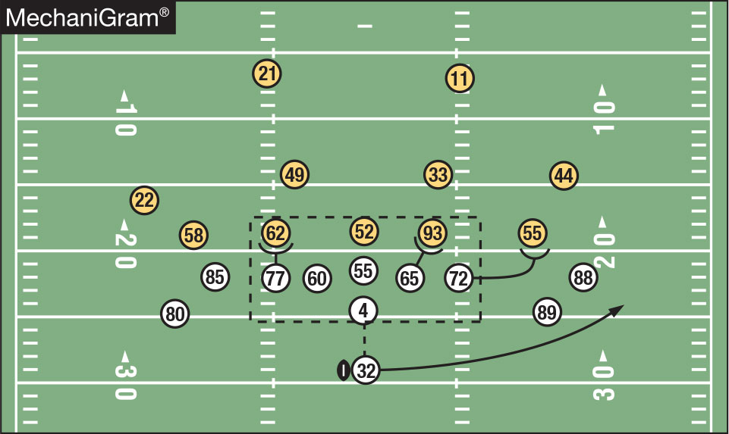
Blocking below the waist Rules 2-17-1, 2-17-2, 2-17-4
It is legal for offensive linemen to block below the waist in the free-blocking zone, provided both players were on their lines of scrimmage and within the zone at the time of the snap and the block is an immediate, initial action following the snap. No. 77 could only block No. 62 below the waist if the block was immediate, initial action following the snap. No. 65 can block No. 93 below the waist even though No. 93 is playing off his shoulder, if the block is an immediate, initial action following the snap. No. 72 could not block No. 55 below the waist at any time during this play.
Notes:
Rules Reminder:
Comment on Slide:
See comments on slide.

Slide 12
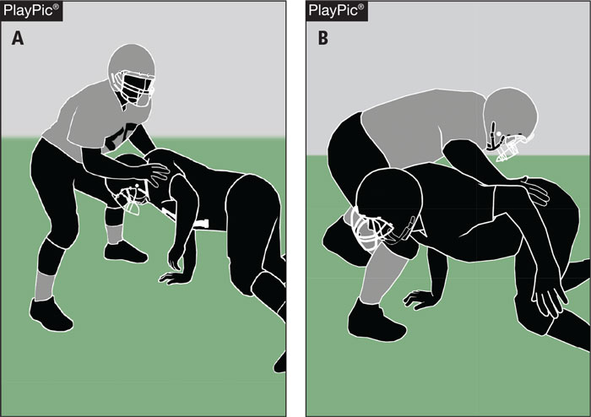
blocking below the waist rules 2-3-7, 2-17-1, 2-17-2, 9-3-2
While in the free-blocking zone, the initial contact in PlayPic A is with the hands below the waist. When the blocker finishes the block below the waist as in PlayPic B, it is not a foul. A block below the waist is legal if it occurs in the free-blocking zone, provided both players were on their lines of scrimmage and within the zone at the time of the snap and the block is an immediate, initial action following the snap.
Notes:
Rules Reminder:
Comment on Slide:
See comments on slide.

Slide 13
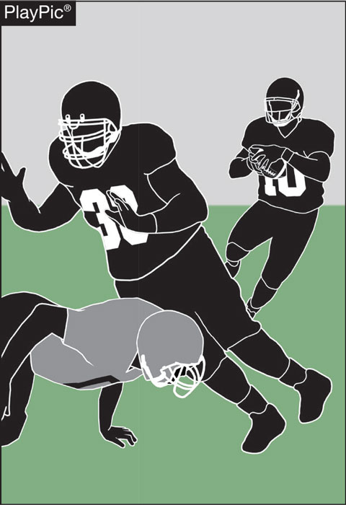
blocking below the waist rules 2-3-7, 2-17-2, 9-3-2
The rules regarding blocking below the waist apply equally to both teams. In the PlayPic, the defender goes below the waist outside the free-blocking zone to take out the lead blocker. This is an illegal block by the defender. A block below the waist is only legal if it occurs in the free-blocking zone, provided both players were on their lines of scrimmage and within the zone at the time of the snap and the block is an immediate, initial action following the snap.
Notes:
Rules Reminder:
Comment on Slide:
See comments on slide.

Slide 14
2022 nfhs football points of emphasis

Slide 15
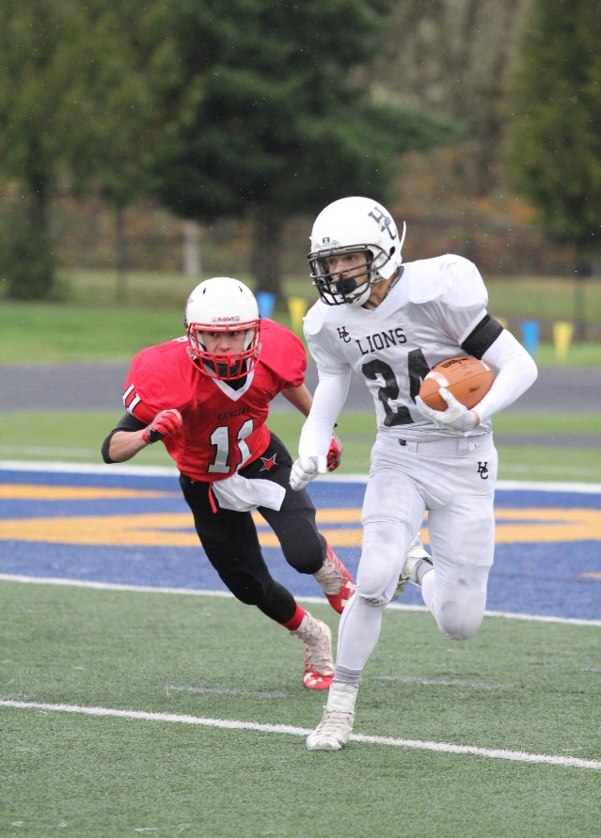
2022 nfhs football points of emphasis
1. Sportsmanship
Targeting/Defenseless Player
3. Legal Uniforms and Equipment
Notes:
Comment on Slide:
The following football points of emphasis were selected by the NFHS Football Rules Committee for the 2022 high school football season. These three football points of emphasis need to be stressed to all coaches, game officials, players, parents, school administrators, appropriate health-care professionals and all others who have an interest in high school football.

Slide 16
sportsmanship
Poor sportsmanship by coaches and players sets a negative tone for fans, game officials and others.
Notes:
Sportsmanship (Point of Emphasis):
Good sporting behavior is one of the fundamental ingredients to the continued success and enjoyment of education-based high school sports and activities. In fact, in the 103-year history of organized high school sports in the United States, good sportsmanship has been one of the most important outcomes of high school activity programs.
NFHS playing rules are written to encourage sportsmanship. Participation in these programs should promote respect, integrity and sportsmanship. However, for these ideals to occur, everyone involved in these programs must be doing their part.
The NFHS is concerned that unsporting behavior in education-based athletics has increased across all sports. As a result, the NFHS has made sportsmanship the No. 1 Point of Emphasis for the 2022-23 school year.
Sportsmanship, or good sporting behavior, is about treating one another with respect and exhibiting appropriate behavior. It is about being fair, honest and caring. When these types of appropriate behavior occur, competitive play is more enjoyable for everyone.
Coaches set the tone during football games with their display of sportsmanship. If these individuals act in a sportsmanlike manner, their behavior sets the tone for players, spectators and others. If coaches, however, are complaining constantly about the decision of game officials, spectators are more likely to do the same.
There must be a collaborative, working relationship between game officials and game administration to promote good sportsmanship and safely conduct the game. Everyone has their roles to play in creating a positive, sportsmanlike atmosphere at games.
Game officials should focus on the actions of players, coaches and other sideline personnel. A positive, open line of communication between game officials and coaches ultimately results in a better game for everyone involved.
Game officials, however, should never engage with spectators who are exhibiting unsporting behavior. Once the game begins, school administration is responsible for dealing with unruly spectators. A proactive approach by school administration includes monitoring the behavior of spectators and intervening as needed.
If spectators are using demeaning or profane language at game officials – or at others in the stands – those individuals should be removed from the game by school administration.
In recent years, a heightened level of unsportsmanlike behavior has been occurring by spectators at high school football games, and it must be stopped. The use of demeaning language, or hate speech, by students, parents and other fans must cease.
High school football and other activities exist to lift people up, not demean or tear people down. The goal is to treat everyone fairly and treat each other with respect. Any speech or harassment that is insulting, demeaning or hurtful will not be tolerated.
High schools must establish a culture that values the worth of every single person – both players on the school’s team and players on the opposing team. There must be a no-tolerance policy regarding behavior that shows disrespect for another individual.
Good sports win with humility, lose with grace and do both with dignity. It takes the efforts of everyone every day to ensure that sportsmanship remains one of the top priorities in education-based activity programs.

